Slide 1
OBJECT
ORIENTED
PROGRAMMING

Slide 2

WHAT IS OOP?
WHAT IS USE OF OOP?
DO WE REALLY NEED OOP?

Slide 3
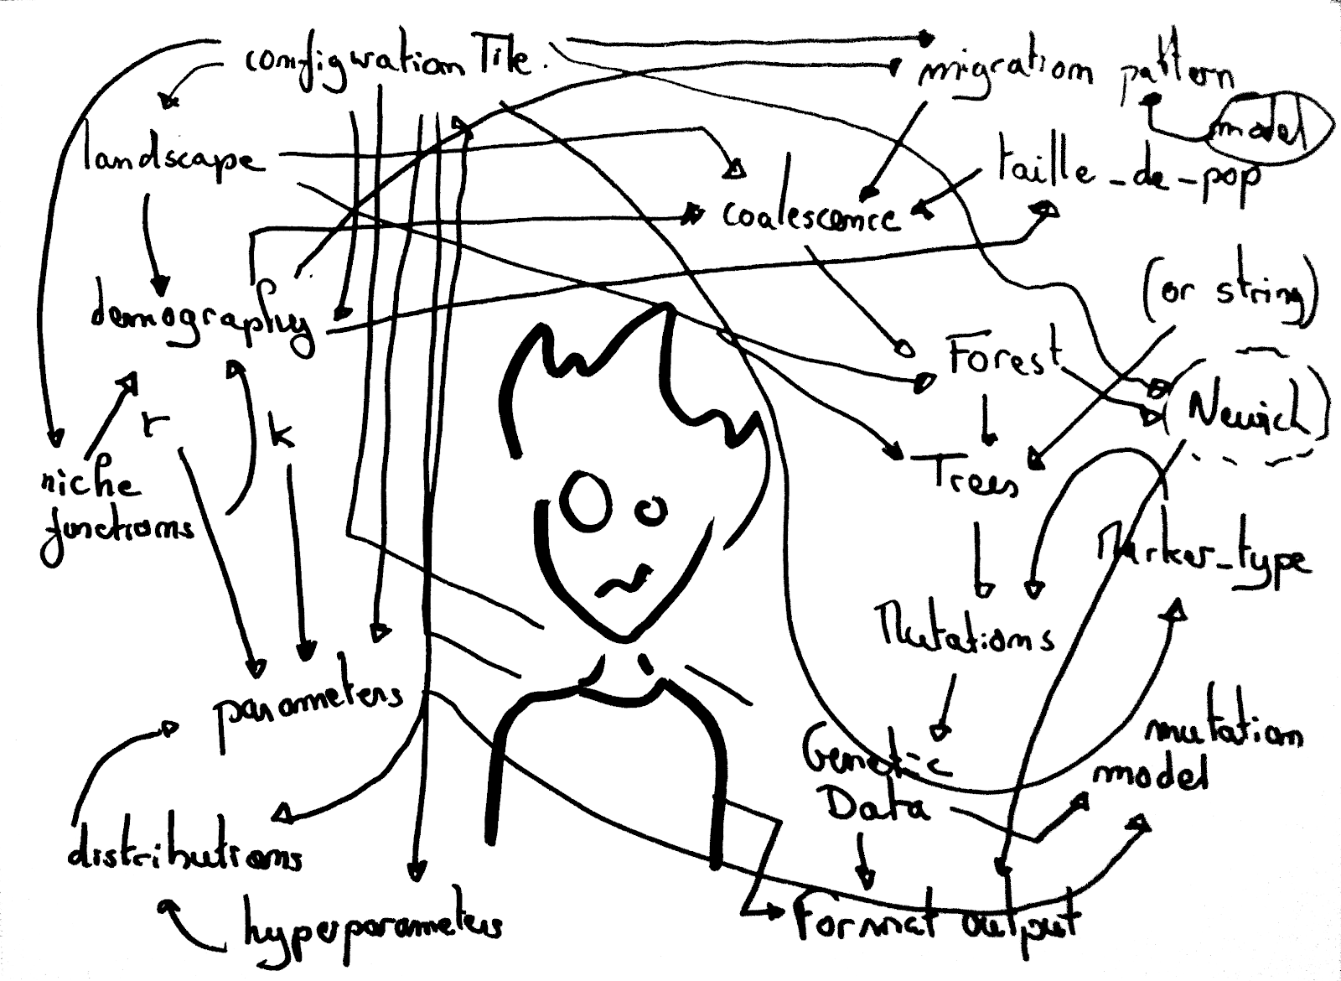
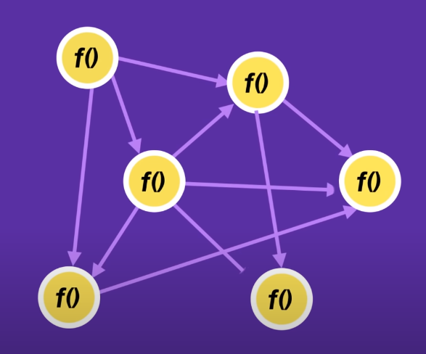
PROCEDURAL ORIENTED PROGRAMMING
Program
f( )
f( )
x
x
Spaghetti Code

Slide 4
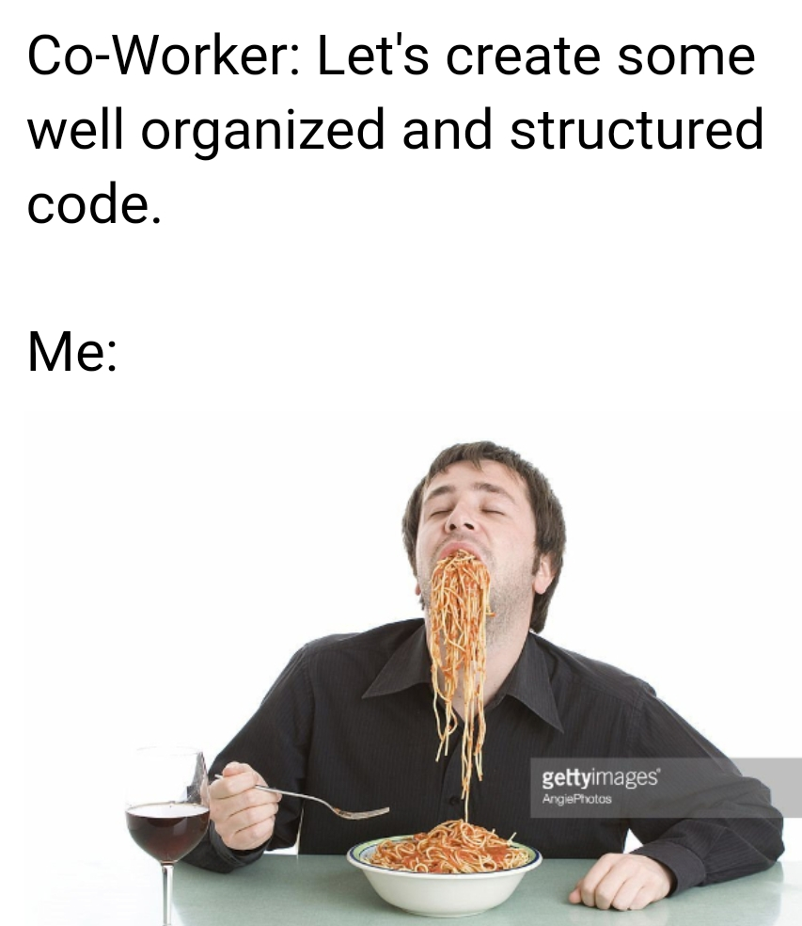
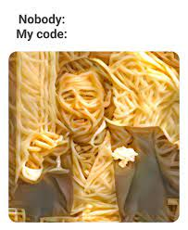
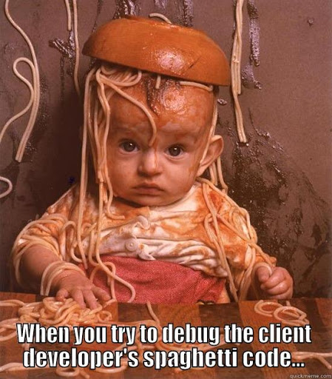

Slide 5
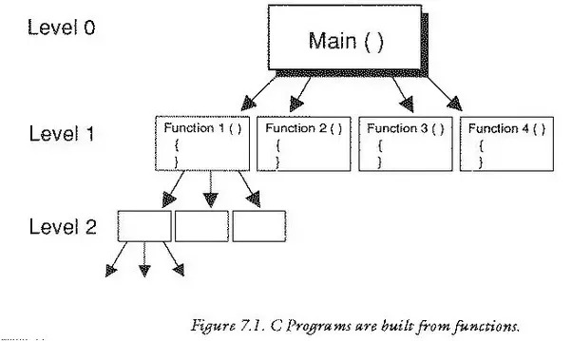
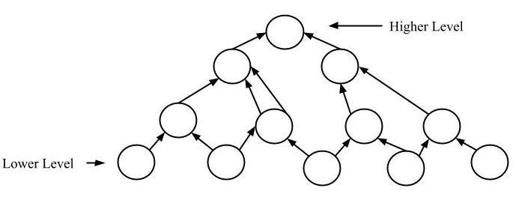
Procedural Oriented
Object Oriented
Top Down Approach
Bottom Up Approach

Slide 6
OBJECT ORIENTED PROGRAMMING
OOP a.k.a Object Oriented Programming is a programming style which is associated associated with Class and objects.
To simplify the complex codes.
This type of approach is used to create a neat and reusable code.

Slide 7
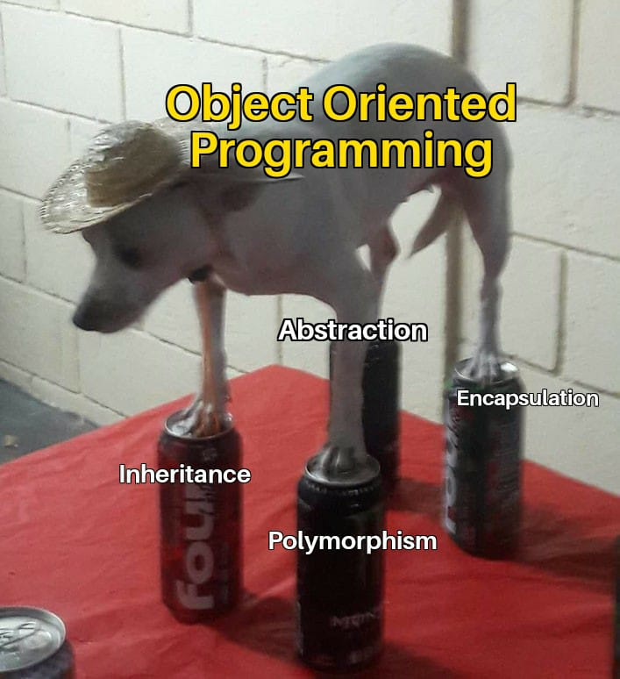
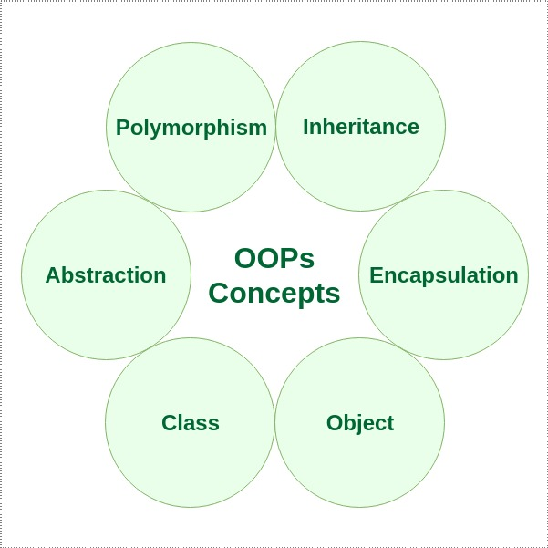
BASIC CONCEPTS OF OOP:
Inheritance
Polymorphism
Abstraction
Encapsulation

Slide 8
CLASS
Dart classes are the blueprint of the object, or it can be called object constructors. A class can contain fields, functions, constructors, etc. It is a wrapper that binds/encapsulates the data and functions together; that can be accessed by creating an object.

Slide 9

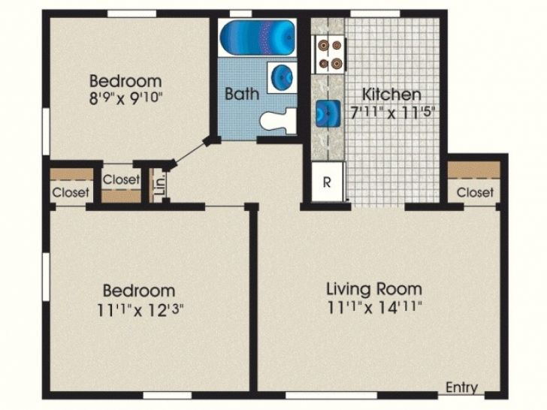
Object/Instance
Object/Instance
Class (Blueprint)
Object/Instance
Object/Instance

Slide 10
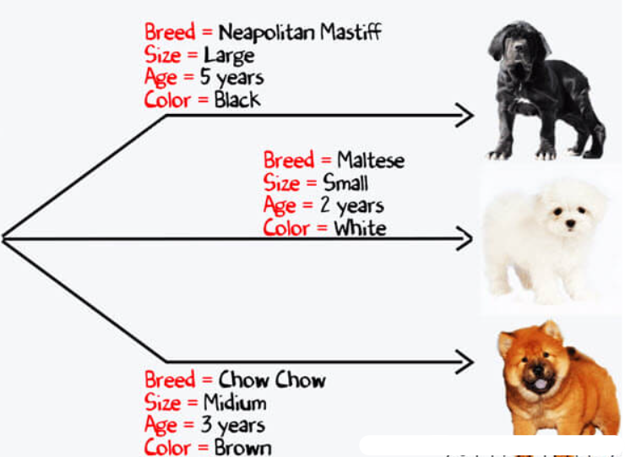
Class dog
Breed
Age
Colour
Properties
Eat( )
Sleep( )
Bark( )
Run( )
Method

Slide 11
void main (){
var dog1 = Dog();
dog1.age=9;
dog1.breed="chihuahua";
print("${dog1.age} and ${dog1.breed}");
dog1.walk();
dog1.bark();
var dog2 = Dog();
dog2.age=5;
dog2.breed="Pug";
print("${dog2.age} and ${dog2.breed}");
dog2.walk();
dog2.bark();
}
//Define properties of a Dog
class Dog{
int? age; //Properties(attribute) of the Dog
String? breed; //Properties(attribute) of the Dog
// These are the methods
void walk(){
print("${this.breed} is now walking");
}
void bark(){
print("${breed} is now barking");
}
}

Slide 12
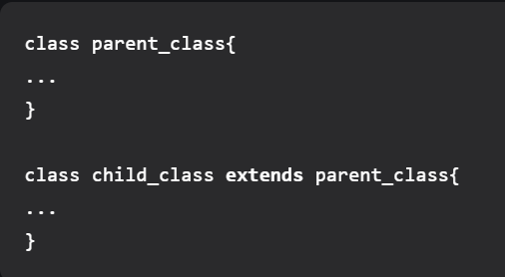

INHERITANCE

Slide 13
Class Chihuahua
Class dog
Class pug
Class dog
Body parts:
Tails
paws
I
N
H
ER
I
T
Body Functions:
Eat( )
Sleep( )
Bark( )
Run( )
Class dog

Slide 14
A
A
B
A
B
B
C
C
Single
Multiple
Multilevel
A
A
B
C
D
B
C
Hierarchical
D
Hybrid

Slide 15
POLY
MORPHISM
(MANY)
(FORMS)

Slide 16
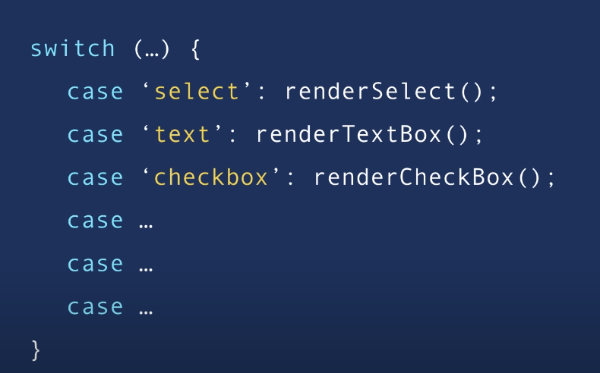
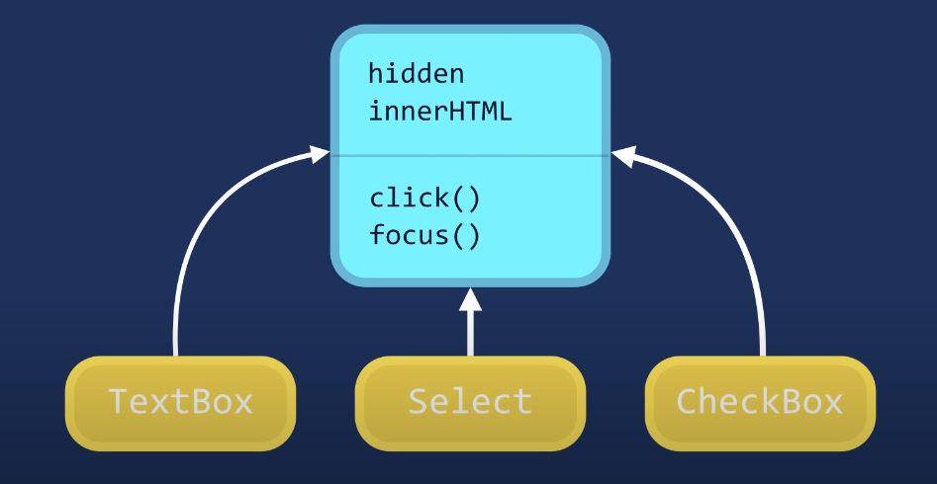
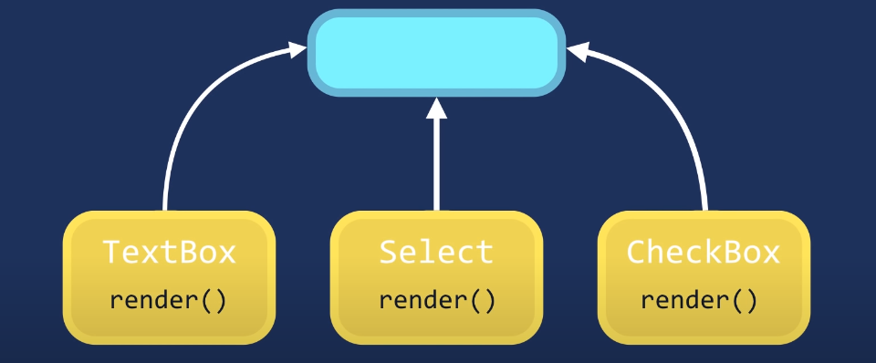


Slide 17
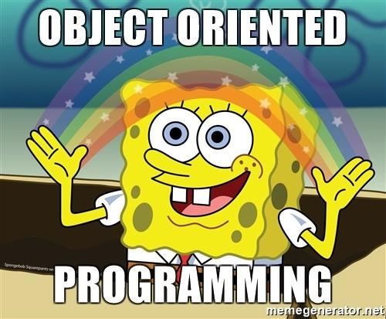
Thank
You :)

Slide 18
REFERENCES
https://www.educative.io/blog/object-oriented-programming
(OOP )
https://www.youtube.com/watch?v=pTB0EiLXUC8
https://www.youtube.com/watch?v=xoL6WvCARJY
(OOP Basic idea)
https://www.geeksforgeeks.org/object-oriented-programming-oops-concept-in-java/
OOP in JAVA(just to get an idea about concept apply it in dart )
https://www.tutorialspoint.com/dart_programming/dart_programming_classes.htm( CLASSES)
https://www.geeksforgeeks.org/dart-classes-and-objects/
(Very very basic of class)
https://youtu.be/sNKKxc4QHqA
(ENCAPSULATION)
https://www.geeksforgeeks.org/abstract-classes-in-dart/
(ABSTRACTION IN DART)
Youtube videos must watch :
https://www.youtube.com/watch?v=apIaNRp7_rs
https://www.youtube.com/watch?v=KdrB-U4kPTM
https://www.youtube.com/watch?v=7xtib79isdQ
https://youtu.be/9Qi-mNYxRQI
https://www.youtube.com/watch?v=spbE8tIZZIo
https://www.youtube.com/watch?v=e80I-Gi6AKo

